Slide 1
Fundaments of azure

Slide 2
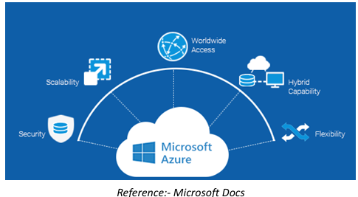
What is Azure?
● Azure is one of the largest cloud service providers in the world.
● It offers you the flexibility to use your preferred tools and frameworks to create, manage, and deploy apps on a large global network.
● Azure's ever-expanding nature makes it one of the finest on the market, and it is also provided by one of the biggest and famous MNCs in Microsoft.
● Azure provides a wide range of services, including computing resources, networking resources, serverless computing, and many more.

Slide 3
Azure Regions
A region is a geographical location on the globe with at least one, but possibly many, data centers close by and connected by a low-latency network.
When you create a resource in Azure, you must define the location/region to which it should belong. There are few exceptions, such as Azure DNS, but generally, all resources must be created with a location specified.
Azure makes it simple to select the data center and regions appropriate for you and your clients, with more announced regions than any other cloud provider (60+).+

Slide 4
Azure Availability Zones
Within an Azure region, availability zones are physically distinct data centers.
Each availability zone comprises one or more data centers that are self-contained in terms of power, cooling and networking.
Availability zones are connected through high-speed, private fiber-optic networks.
The goal of having more than one availability zone in a region is to allow data to be redundantly stored in more than one availability zone, ensuring that even if a data center fails, it does not affect our resources.

Slide 5
Azure Architecture for management of Resource

Slide 6
Azure Subscriptions
● As the name implies, a subscription is a logical entity that grants access to deploy and consume Azure resources.
● A resource may be anything from a virtual machine to a storage account or something that's related to networking.
● Almost anything in Azure can be utilized as a resource.
● A subscription is something that can be purchased and used for a certain amount of time. The same is true for Azure subscriptions.
Azure Management Groups
● A company may use Azure management groups to govern and manage access, compliance, and rules for their subscription inside their tenancy.
● An azure management group comes under the azure subscription in the hierarchy of management of resources in Azure.
● A subscription can only have one management group.

Slide 7
Azure Resource Group
● A resource group is a next level in the hierarchy of Azure Architecture. A resource group is the logical mapping of the resources.
● For Creating Any Resource, you need a resource group.
● An Azure Management group is optional. However, azure resource groups and subscriptions are required. Resource groups can’t be nested.
Azure Resources
● A resource is something that is used to manage services in azure.
● At any one moment, a resource can only be in one resource group.
● The final component in the Azure architectural hierarchy is the resource.
● A resource group and a resource can be in two different locations; there is no restriction.

